Slide 1
Programming for Problem solving
SEMESTER: 1

Slide 2
UNIT-1 Introduction to computer and programming Topic-3
Language Translators
Compiler
Interpreter
Assembler
Compiler Vs. Interpreter
Programming Languages
Low Level Language
High Level Language
Low Level Language Vs. High Level Language

Slide 3
Language Translators
The programs are written mostly languages like Java, C++, Python etc. and are called source code.
A computer understands instructions in machine code, i.e. in the form of 0s and 1s.
source code cannot be executed directly by the computer and must be converted into machine language to be executed.
Special translator system software is used to translate the program written in high-level language into machine code is called Language Translator.
The program after translated into machine code (object program / object code).

Slide 4
Language translators
Compiler
Interpreter
Assembler

Slide 5
Compiler
A compiler is a computer program that transforms code written in a high-level programming language into the machine code.
A compiler should comply with the syntax rule of that programming language in which it is written.
The compiler is only a program and cannot fix errors found in that program.
Programming languages like C, C++, Java use compilers.
Source Program
Hi.C
void main()
{
printf(“Hi”);
}
Compiler
Machine Code
Hi.exe
11011010010
0100111010110100011010

Slide 6
Interpreter
An interpreter is a computer program, which coverts each high-level program statement into the machine code.
Interpreters convert code into machine code when the program is run.
The interpreter moves on to the next line for execution only after removal of the error.
Directly executes instructions written in a programming or scripting language without previously converting them to an object code or machine code.
Programming languages like JavaScript, Python, Ruby use interpreters.

Slide 7
Assembler
The Assembler is used to translate the program written in Assembly language into machine code.
The source program is a input of assembler that contains assembly language instructions.
The output generated by assembler is the object code or machine code understandable by the computer.
Source Program
(Mnemonic opcode,
Symbol)
Assembler
Object Code

Slide 8
Compiler Vs. interpreter
compiler
Interpreter
Scans the entire program and translates it as a whole into machine code.
Compilers usually take a large amount of time to analyze the source code.
Execution time is comparatively faster than interpreters.
Generates intermediate object code which further requires linking, hence requires more memory.
Programming languages like C, C++, Java use compilers.
Translates program one statement at a time.
Interpreters usually take less amount of time to analyze the source code.
Execution time is comparatively slower than compilers.
No intermediate object code is generated, hence are memory efficient.
Programming languages like JavaScript, Python, Ruby use interpreters.

Slide 9
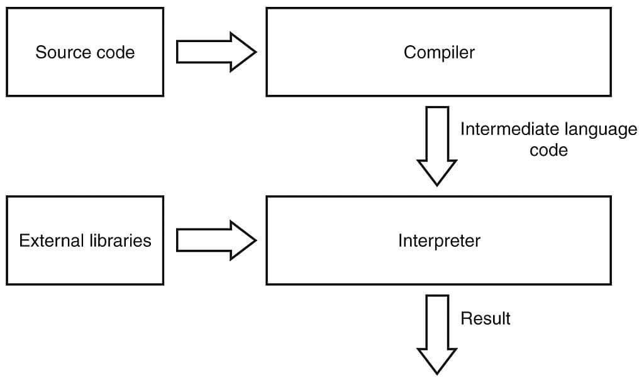
Compiler Vs. interpreter
compiler
Interpreter

Slide 10
Programming Languages
Programming language is the language of computers.
Through programming language, we can communicate with a computer system.
Programming languages are used to create programs. A computer program is intended to perform some specific task through computer or to control the behavior of computer.
Using a programming language, we write instructions that the computer should perform. Instructions are usually written using characters, words, symbols and decimal.
later encoded to the computer understandable language i.e. binary language.

Slide 11
Programming Languages
Languages
Low Level
High Level
Medium Level

Slide 12
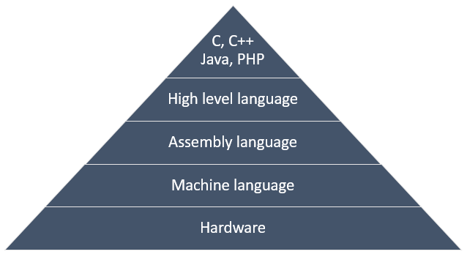
Programming Languages
Abstraction level of programming languages from hardware

Slide 13
Low-Level Language
Low level languages are languages close to the machine level instruction set.
A low-level programming language interacts directly with the registers and memory.
Programs developed using low level languages are machine dependent and are not portable.
Low level language does not require any compiler or interpreter to translate the source to machine code.
Assembly Language
Uses Mnemonics to represent Codes
Machine Language
Programs are written in 0’s and 1’s.
Ex. ADD R2,10
Ex. 00000001 00101010

Slide 14
HIGH-Level Language
High level languages are similar to the human language.
Programmers friendly, easy to code, debug and maintain.
Provides higher level of abstraction from machine language.
High level programs require compilers/interpreters to translate source code to machine language.
Machine Independent
Based on Execution Model
Compiled Language
Interpreted language
Based on Programming Paradigm
Structured Language
Procedural Language
Object Oriented Language

Slide 15
Low Level Language VS. High Level language
Low Level Language
High Level language
They are faster than high level language.
Programming in low level requires additional knowledge of the computer architecture.
They are machine dependent and are not portable.
Debugging and maintenance is difficult.
They are generally used for developing system software’s (Operating systems) and embedded applications.
They are comparatively slower.
Programming in high level do not require any additional knowledge of the computer architecture.
They are machine independent and portable.
Debugging and maintenance is comparatively easier.
They are used to develop a variety of applications such as – desktop applications, websites, mobile software’s etc.

Slide 16
References
https://codeforwin.org/2017/05/programming-language-history-popular-languages.html
https://www.sitesbay.com/cpp/cpp-compiler
https://www.geeksforgeeks.org/language-processors-assembler-compiler-and-interpreter/
https://nptel.ac.in/courses/106/104/106104128/
https://youtu.be/kb0MG6oUCTw

